Slide 1

Prediction of Hospital Readmissions Within 30 Days
Leveraging Machine Learning for Healthcare Improvement
Bangalore June 2024 - Group 2
Mentor: Mr. P. V. Subramanian

Slide 2
Project Life Cycle
Phases:
1. Problem Understanding
2. Data Collection
3. Data Cleaning & Preprocessing
4. Exploratory Data Analysis
5. Feature Engineering
6. Model Building & Evaluation
7. Insights & Recommendations

Slide 3
Introduction
Hospital Readmissions: Major challenge impacting patient outcomes and healthcare costs.
Objective: Develop a robust framework to predict 30-day hospital readmissions using machine learning.
Key Challenges:
High costs and penalties (e.g., Medicare).
Complex patient profiles.
Data quality issues (missing, noisy data).
Limited predictive accuracy of traditional models.

Slide 4
Dataset Overview
Source: UCI Machine Learning Repository – Diabetes 130-US Hospitals (1999-2008).
Size: 101,766 records and 50 features.
Preprocessing:
Removed irrelevant columns (e.g., ID variables).
Addressed missing values (e.g., Iterative Imputer).
Data of passed away patients were dropped(referencing discharge_disposition_id)

Slide 5
Target Variable
We derived the target variable, 'Target' as follows:
Target value: 0 -- Readmitted NO and Readmitted > 30
Target value: 1 -- Readmitted < 30
Preprocessing:
Imbalanced dataset was found
11.32% of observations for the minority class
Applied SMOTE (Synthetic Minority Oversampling Technique).
Combined with SMOTEENN for handling both over- and under-sampling.

Slide 6
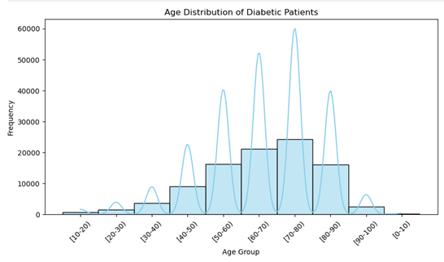
Exploratory Data Analysis
Key Visualizations and Inferences:
Histograms: Age vs Readmission Risk in Diabetic Patients.
The histogram shows a peak in the 60-80 years age group, indicating older individuals are more prone to diabetes. This may correlate with higher readmission rates, emphasizing the need for targeted healthcare interventions.

Slide 7
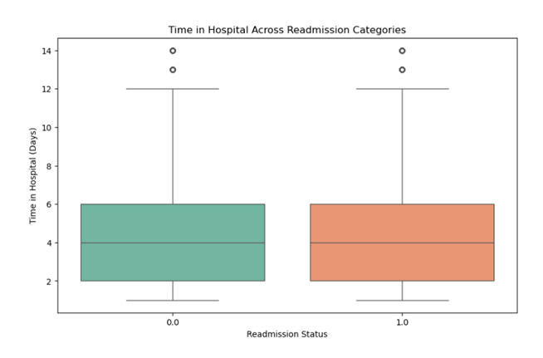
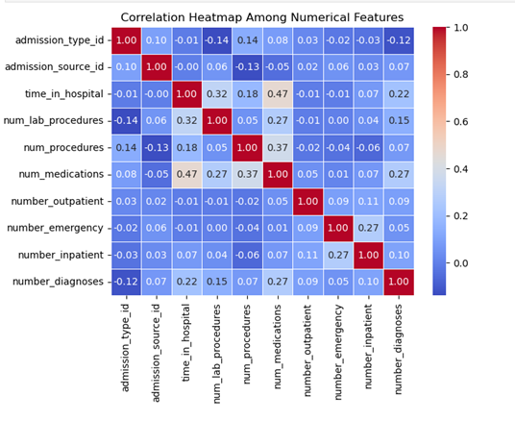
The boxplot shows no significant variation in hospital stay time across readmission categories, suggesting that other factors may drive readmissions.
The heatmap shows weak correlations among numerical features, indicating these variables are largely independent. Further analysis, including variable interactions or non-linear relationships, may reveal stronger patterns.

Slide 8
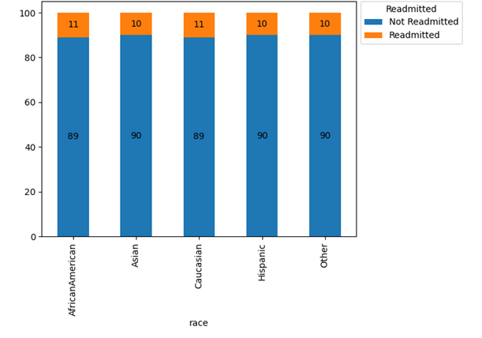
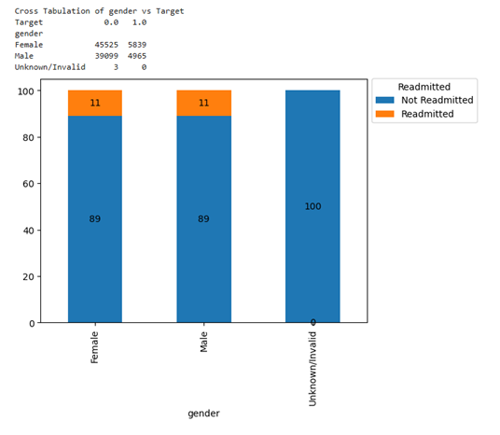
Bar Plots: Race and gender had minimal impact on readmission rates.
Readmission rates show no racial pattern, indicating other factors like healthcare access and socioeconomic conditions may play a larger role.
The analysis shows minimal gender differences in readmission rates, suggesting gender isn't a significant factor. Further analysis of other factors may reveal additional insights.

Slide 9
Feature Selection
Techniques Used:
Recursive Feature Elimination (RFE): Iteratively removes least important features.
Variance Inflation Factor (VIF): Identifies and removes multicollinearity among features.
Top Features:
Number of Inpatient Visits: Correlates with readmission risk.
Discharge Type: Affects post-hospital care needs.
Medical Specialty: Reflects care type and readmission potential.
Age: Key factor in readmission risk, especially for older patients.
Medications: Certain medications indicate high-risk conditions.
Inference:
The selected features were the most influential in predicting patient readmissions, highlighting their critical role in model accuracy.

Slide 10
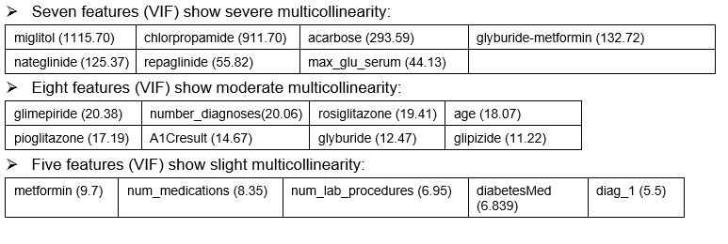
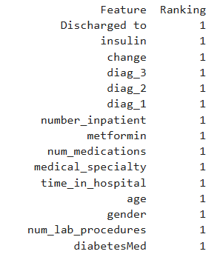
Why are these features important?
They provide insights into the patient's health condition, For example:
Older patients and those with multiple chronic conditions may be more prone to readmission.
Longer hospital stays and complex medical histories can increase the risk of complications.
Changes in medication or new diagnoses may require additional care or monitoring.
Diabetes-related factors are crucial because diabetes can lead to various complications that may necessitate readmission.

Slide 11
Models Evaluated
Algorithms Used:
Logistic Regression, Naïve Bayes, KNN, Decision Tree, Random Forest, XGBoost, AdaBoost. Selection based on variety in model complexity and handling different data patterns.
Evaluation Metric:
Recall (Primary focus on minimizing false negatives to ensure high-risk patients are identified).
Cross-Validation:
10-Fold Cross-Validation to assess model stability and generalizability.
Hyperparameter Tuning:
Fine-tuning model parameters (e.g., learning rate, tree depth) to optimize recall.

Slide 12
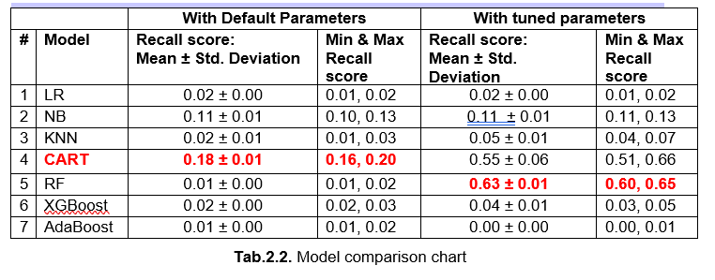
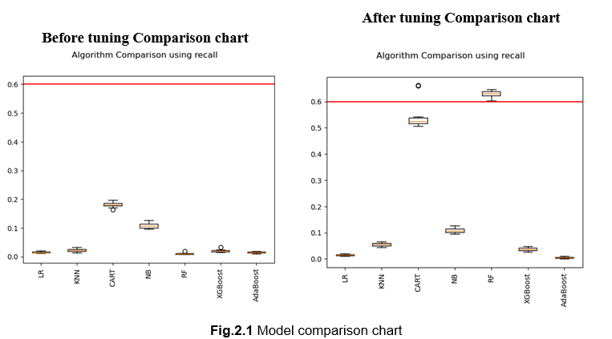

Slide 13
Model Performance
Before Tuning:
Best Recall: Decision Tree (18%), Random Forest (1%)
After Tuning:
Decision Tree: 55% (+205%)
Random Forest: 63% (+6200%)
Inference:
Hyperparameter tuning significantly improved recall, especially for Random Forest, indicating that model optimization can drastically enhance performance in identifying high-risk patients.

Slide 14
Key Insights and Implications
Important Features:
Number of Inpatient Visits
Discharge Type
Practical Applications:
Prioritize follow-up care for high-risk patients
Optimize resource allocation based on patient risk
Policy Recommendations:
Implement tailored care plans for high-risk patients
Enhance discharge planning to reduce readmissions

Slide 15
Closing Reflections
Achievements:
Demonstrated the practical applicability of machine learning in
predicting patient readmissions, showcasing its potential to improve healthcare outcomes.
Future Directions:
Modern Datasets: Incorporate more diverse and up-to-date datasets to enhance model accuracy and generalizability.
Deep Learning: Explore advanced techniques like deep learning to capture complex patterns and improve prediction precision.
Real-World Pilots: Implement models in real healthcare settings to assess performance and refine them based on actual patient data.

Slide 16

Thank You
Group members:
Rahul Y.
Aswin
Preeti D.
Bhavitha S.
Nishith R.
Lohith T S

